Slide 1
Radiation Energy Deposition on an Asteroid
2d Lt Ashwin Rao
Air Force Institute of Technology
6 December, 2018

Slide 2
Overview
Problem
Project Goals
Key concept
Methodology
Results
Conclusions
Notes:
Goals, Lit, Exp, Model, optimize, results, conc.

Slide 3
Problem
Asteroid impact on earth could be catastrophic^{[9]}
Potential solution: use a nuke^{[5]}
Detonate some distance away from surface
Fragment, ”blow-off” enough material to change path
Dependent on energy deposited from detonation^{[1]}
Radiation interactions with asteroid (scattering, absorption)
Notes:
Goals, Lit, Exp, Model, optimize, results, conc.

Slide 4
Project Goals
Create an MCNP model of an asteroid and use MCNP to characterize energy deposition from different types of radiation
Calculate total energy deposition, develop depth profile
Modify SDEF card with built in 14.1 MeV source to analyze effects of different particles/energies
Use Watt spectrum
Notes:
Model
Automated Opitmizaiton
ADVANTG adjoint Flux calc

Slide 5
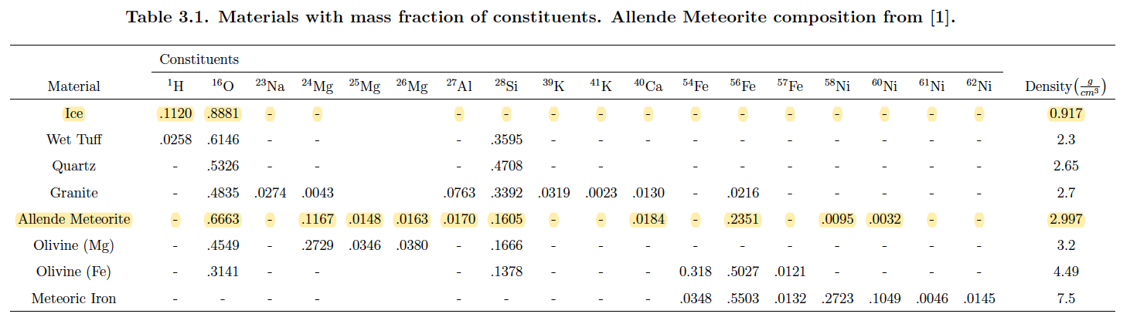
Previous Work
MAJ Ferguson’s thesis. ^{[1]}
Used MCNP input files as a base for testing different radiation
Allende meteorite ^{[2][4]} and ice compositions
Notes:
Manufacturer issues
10-0.2% range
Deadlayer/Active Volume changes

Slide 6
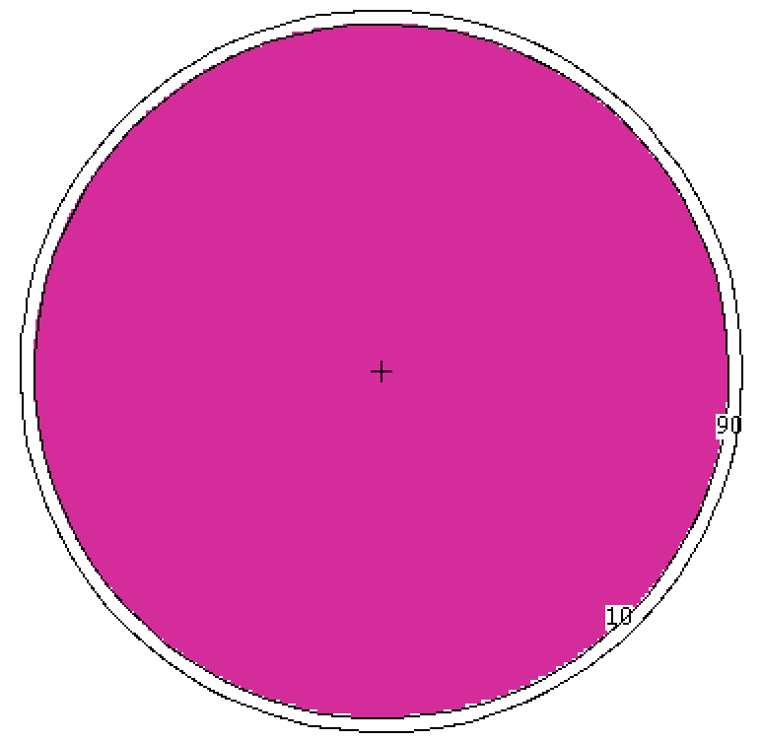
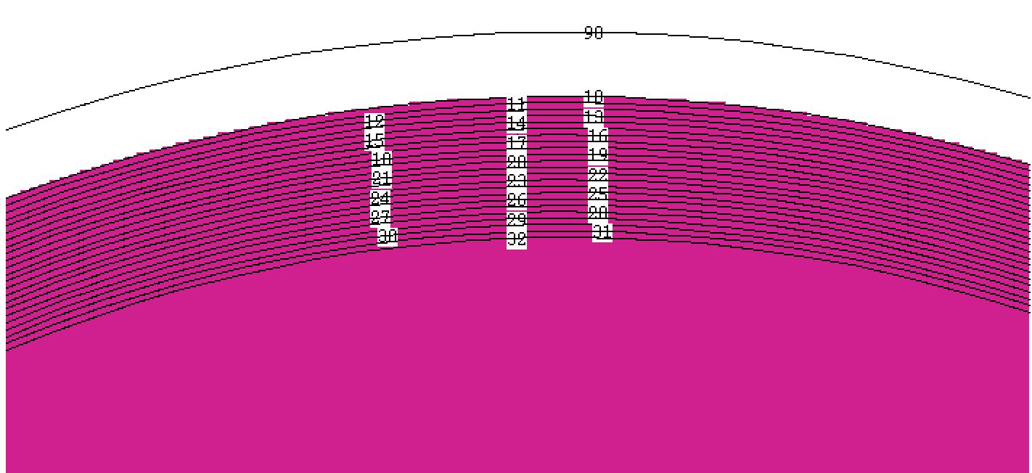
MCNP Model
25 m radius asteroid^{[7]}
Point source: 100, 10, 1 cm away from surface
Thermal, 0.5, 1, 14.1 MeV, Watt spectrum Neutrons
1, 5, 10, 20 keV X-Rays
+F6 tally (energy dep from all particles) ^{[3]}
Total E_{dep} and depth profile tallies
Notes:
experiment

Slide 7
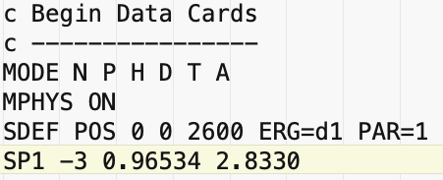
Example Input: SDEF card
Varied: POS, ERG, PAR to test different detonation distances, source particles, particle energies
Watt Spectrum: varying constants did not drastically affect E_{dep}
Notes:
Visual, copper lining to prevent X-ray/electron backscatter

Slide 8
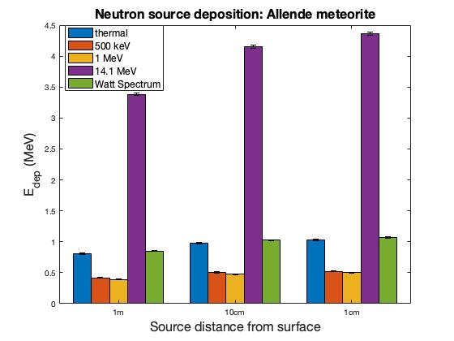
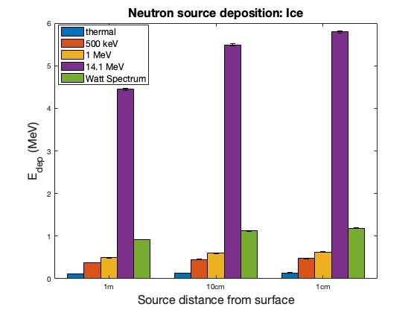
Results
Notes:
Sufficient Energy Range

Slide 9
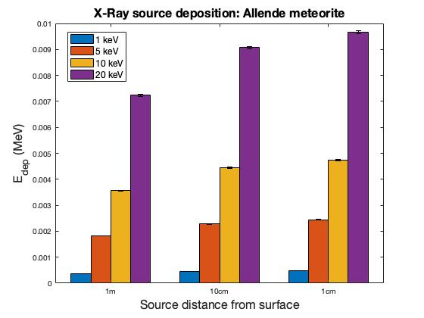
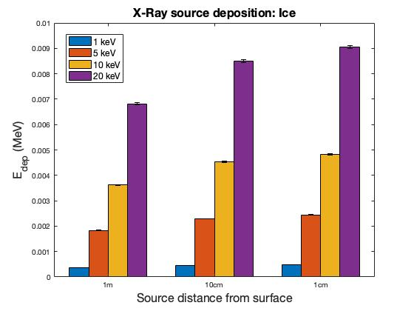
Results
Notes:
Sufficient Energy Range

Slide 10
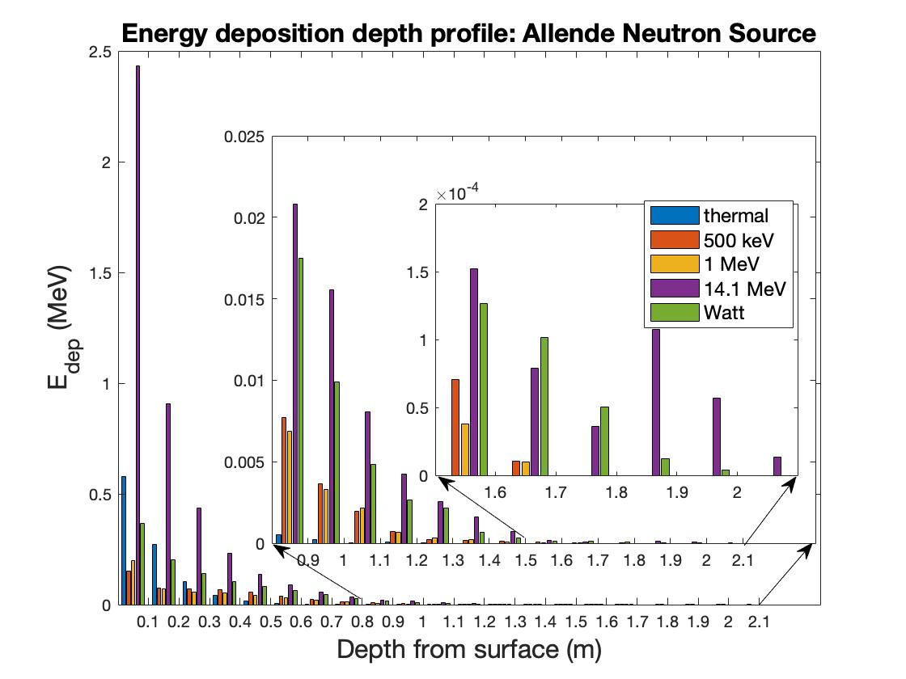
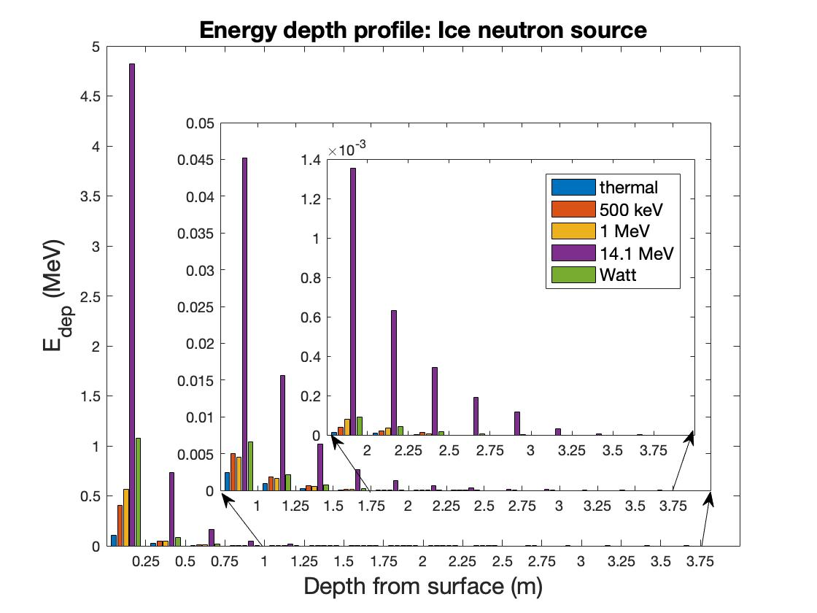
Results
Notes:
Sufficient Energy Range

Slide 11
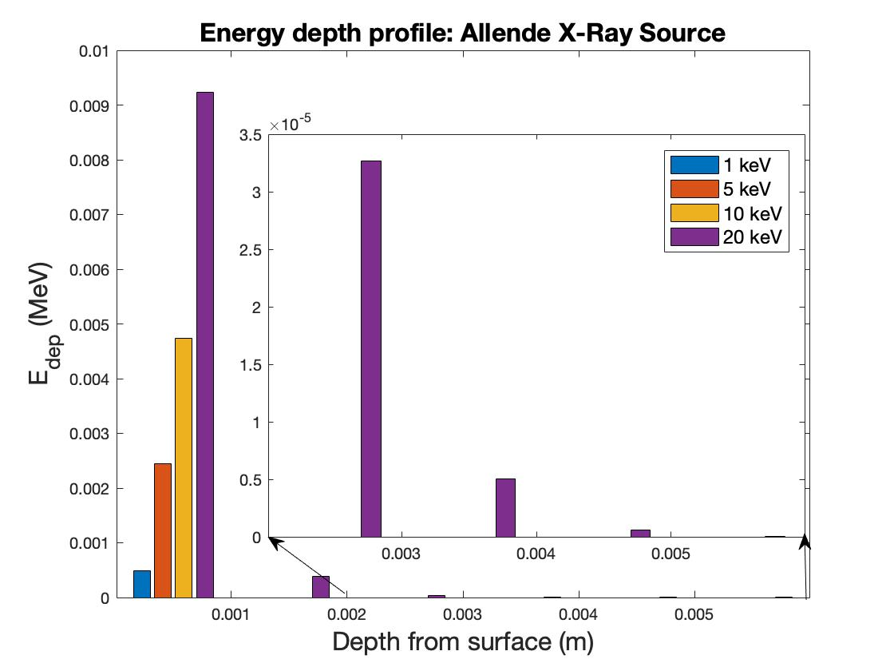
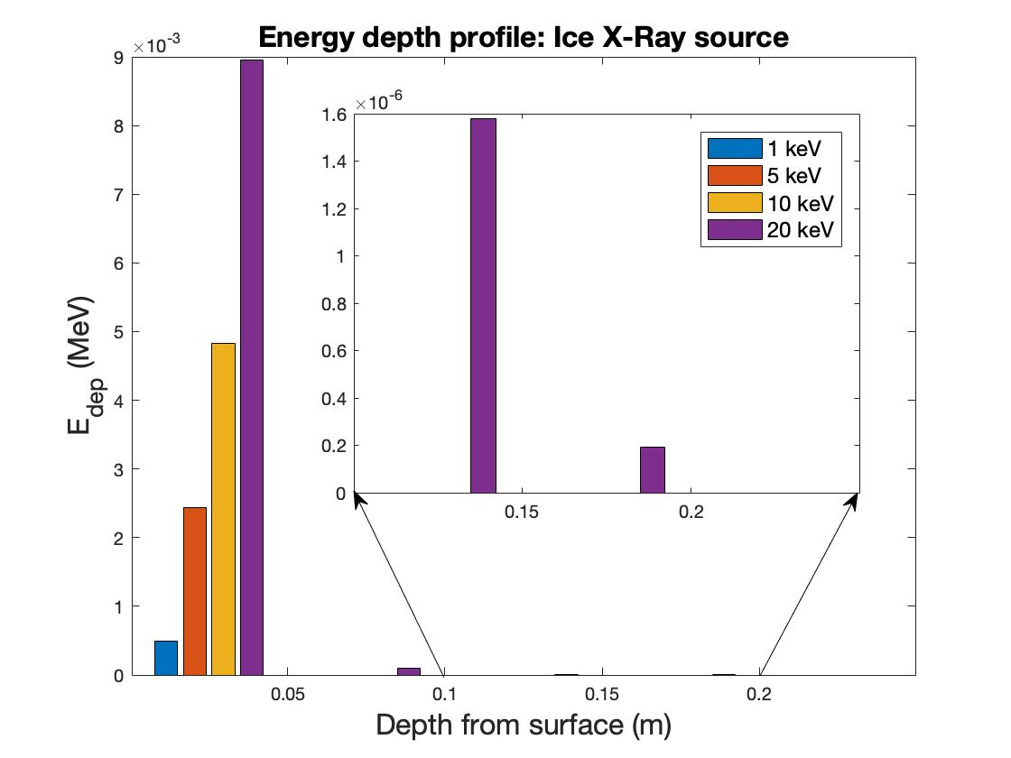
Results
Notes:
Sufficient Energy Range

Slide 12
Conclusion
E_{dep} is highly dependent on particle type and energy.
Higher source energy = higher E_{dep}
Dependent on isotopic composition of target.
Function of reaction cross sections of asteroid^{[6]}.
Detonation distance and E_{dep} inversely related.
Neutrons more penetrating than hard x-rays

Slide 13
Future Work
More detailed source term
Include all types of radiation particles, spectrum for each
More detailed mesh to tally depth profile radially and across surface

Slide 14
Summary
Problem
Project Goals
Previous Work
MCNP Model
Results
Conclusions

Slide 15
Acknowledgements
Provided project assistance, Captain James Bevins, AFIT
Provided MCNP template and composition data, MAJ Aaron Ferguson, USA^{[1]}
Michael Bay, Bruce Willis^{[9]}

Slide 16
References
Github repository
[1] Ferguson, Aaron J. Analysis of Neutron Effects for Asteroid Disruption. 2016. Air Force Institute of Technology. Master’s Thesis.
[2] E. Jarosewich, R. S. Clarke, and J. N. Barrows, ”The Allende meteorite reference sample,” Smithsonian Contributions to the Earth Sciences, vol. 27, p. 49, 1987.
[3] D. B. Pelowitz, ”MCNP6 User’s Manual Version 1.0,” Los Alamos National Laboratory, Los Alamos National Laboratory, 2013.
[4] R. MCCONN, ”Compendium of Material Composition Data for Radiation Transport Modeling,” Pacific North Western National Laboratory, Richland, WA (2011).
[5] S. S. Board et al., Defending Planet Earth:: Near-Earth Object Surveys and Hazard Mitigation Strategies. National Academies Press, 2010.
[6] ”ENDF/B-VII.1 Evaluated Nuclear Data Library.” [Online]. Available: http://www.nndc.bnl.gov/endf/b7.1/
[7] ”NEO Discovery Statistics.” [Online]. Available: http://neo.jpl.nasa.gov/stats/goall
[8] Bodansky, David. Nuclear Energy: Principles, Practices, and Prospects. 2nd ed., Springer, 2005.
[9] Bay, Michael, director. Armageddon. Touchstone Pictures, 1998.

Slide 17

Questions?
[9]

